Slide 1
Botox for migraine
Swedish Neurology Week, 2014
Dr Peter Grenholm

Slide 2
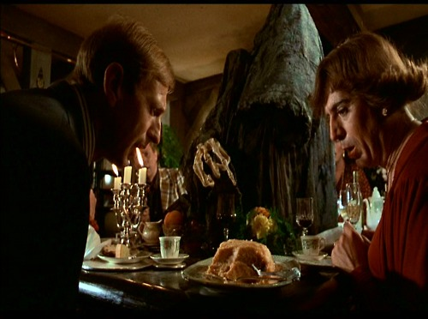
”It’s the mousse”
Botox is an extremely strong poison. 0.1g is enough to kill a million people.

Slide 3
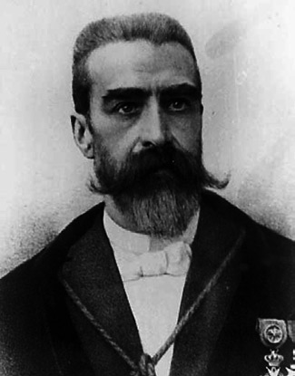
Botulinum Toxin
The latin name means “sausage poison”, discovered 1817 by Justinus Kerner (image)
It’s produced by the bacterium Clostridium Botulinum, discovered 1895 by van Ermengem
It blocks neuromuscular transmission (several research groups, 1949-1993)
Eight serotypes (A-G, C2)

Slide 4
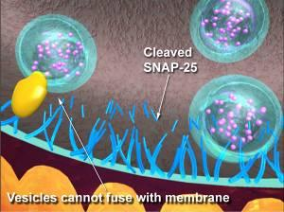
Mechanism of Action
Causes muscle weakness
Maximal effect after two weeks and lasts 3-6 months.

Slide 5
Medical uses
Strabismus (squint), 1980, Alan. B. Scott
Blepharospasm, hemifacialisspasm (facial twitches)
Cosmetics
Dystonia (muscle spasms in neck, arms and feet)
Hyperhidrosis (excessive sweating)
Spasticity
Neurogenic bladder
Pain
…

Slide 6
Botox for pain?
Used for pain and tension type headaches but no real evidence.
First licensed use for pain is chronic migraine.
The theory is that botulinumtoxin also blocks transmission in sensory nerves.

Slide 7
Chronic migraine (ICHD-II 1.5.1)
Headache at least 15 days each month
At least 8 of these days have migraine features

Slide 8
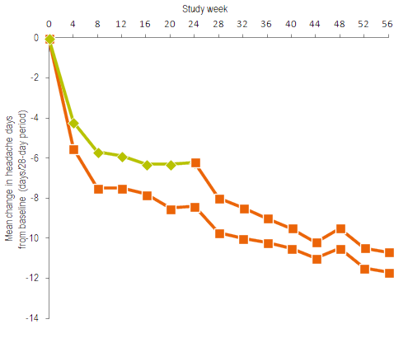
Chronic migraine: PREEMPT
Comparison with placebo week 0-24, then all had botox.
Diener et al, Cephalalgia 2010, 30(7):804-814

Slide 9
PRREMPT: cont
Significant effect compared to placebo but:
  Easy to tell if you’ve had botox, so treatment wasn’t blinded
  Very large placebo effect
Cumulative effect after second and third treatment.

Slide 10
Other research
Seven studies (N=675) on tension type headache: no effect
Five studies (N=1838) on episodic migraine: no effect
      Jackson et al, JAMA 2012, 307:1736

Slide 11
Daily headache
Migraine
Tension Type Headache
Medication Overuse Headache
4% prevalence

Slide 12
Daily headache – what other help is there?
Physiotherapy, acupuncture
Stopping pain killers
Migraine preventatives, antidepressants
Only a small proportion is seeing a neurologist

Slide 13
Migraine preventatives
Beta blockers
Candesartan
Topiramate
Valproate
Amitriptyline
Venlafaxine/Duloxetine
Botulinum toxin

Slide 14
Migraine botox clinic
Appointment every 12th week
31 injections in head and neck, total dose 155U
The effect can be evaluated after 2-3 treatments

Slide 15
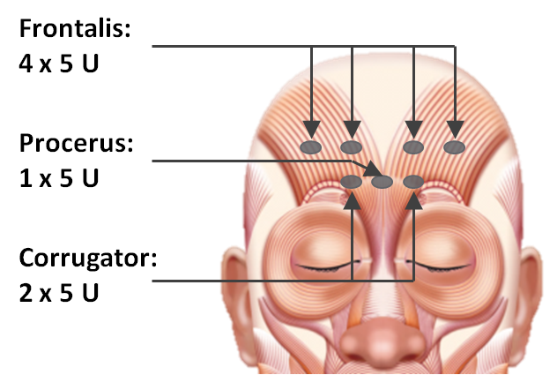
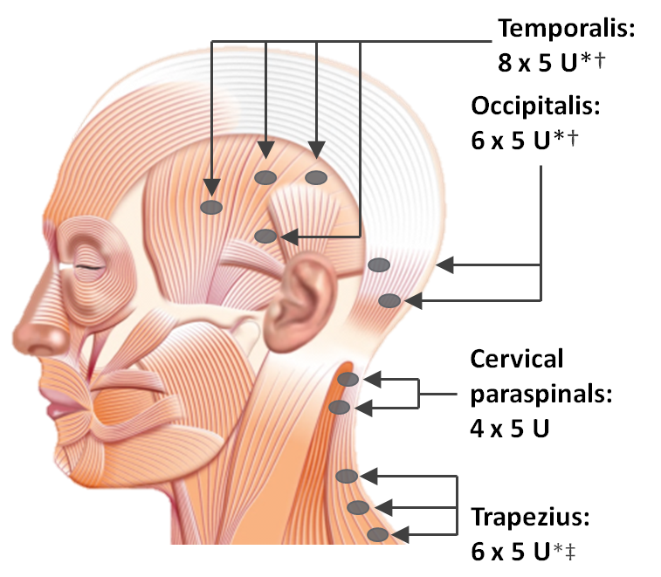
Injections following PREEMPT

Slide 16
Is it dangerous?
Deadly intravenous dose for a chimpanzee is 3000E
… allergic reactions are extremely rare (1/10000)
Common side effects are pain, bruises, weakness in neck or in eyebrows. This resolves within a couple of months.

Slide 17

Sometimes the eyebrows become slanted as in this poster - this is called the Mephisto effect and can be avoided

Slide 18
Migraine botox clinic
I Uppsala behandlas idag ca 30 patienter, de flesta
  Hade fått botox någon annanstans med god effekt eller
  Hade aktuell kontakt med oss och provat många perorala läkemedel eller
  Kände någon som börjat med botox
Ökande remissflöde
I Uppsala finns sannolikt flera tusen personer med kronisk migrän, vilka ska få behandling?

Slide 19
Migraine botox clinic
Has tried three oral preventatives, and addressed medication overuse.
Has tried lifestyle modifications and physiotherapy.
Keeps a headache diary
Evaluation after two cycles.
If insufficient effect of PREEMPT, the dose can be increased by 30 U.

Slide 20
Experiences
Effect varies from none at all to very good
Side effects are mild
Difficult to know when to stop treatment
It’s not just the injections, it’s also getting to see a headache specialist regularly.

