Slide 1
Headache
2025
Peter Grenholm, Consultant Neurologist, UHD

Slide 2
Tension 26%
Why I am here today
Migraine 14 %
Chronic 4%
52% of the world’s population has active headache disease; 16% have a headache today.
Stovner et al, J Headache Pain 2022, from Global Burden of Disease 2020

Slide 3
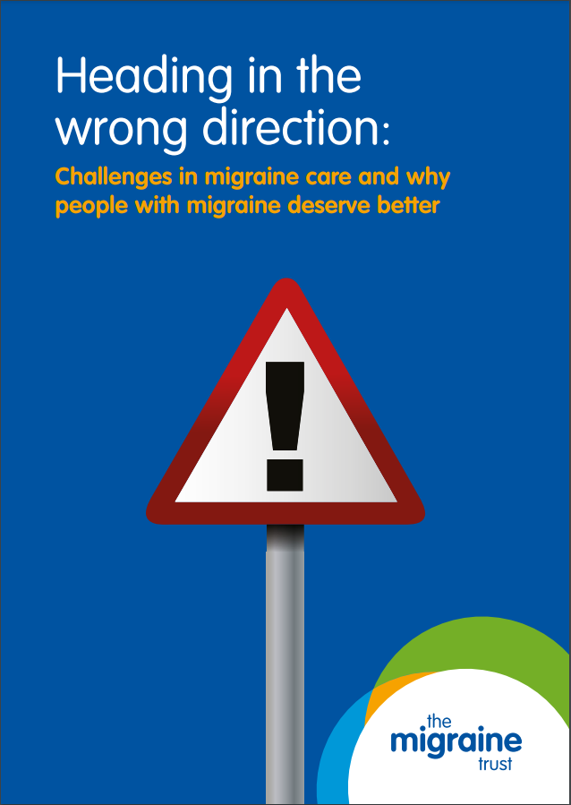
We need to find new ways
Primary care treatment with hospital support
GP diagnosis and first line treatment
Headache nurse for advanced treatment
Access to A&G and MRI when needed

Slide 4
Disclosures
Pfizer and Abbvie sometimes buy food when I speak.

Slide 5

Plan for today
Acute headache
When to scan /refer
Migraine management
The new drugs

Slide 6
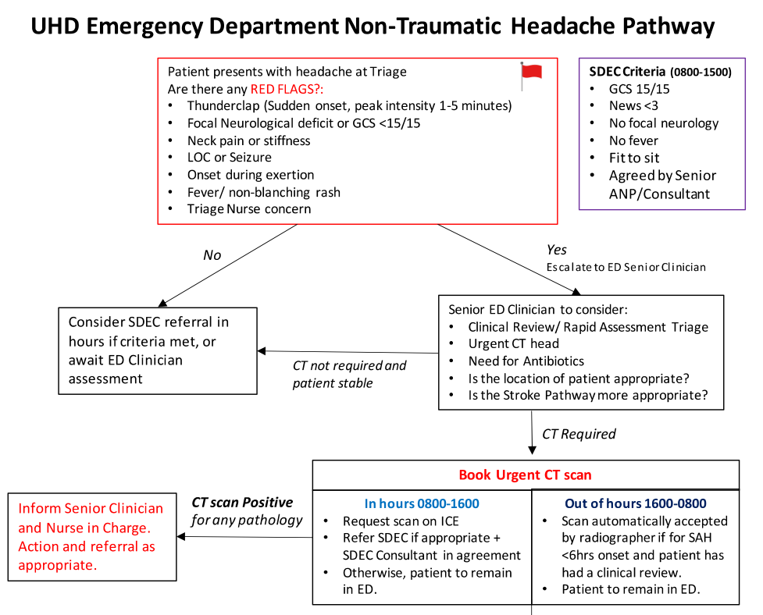
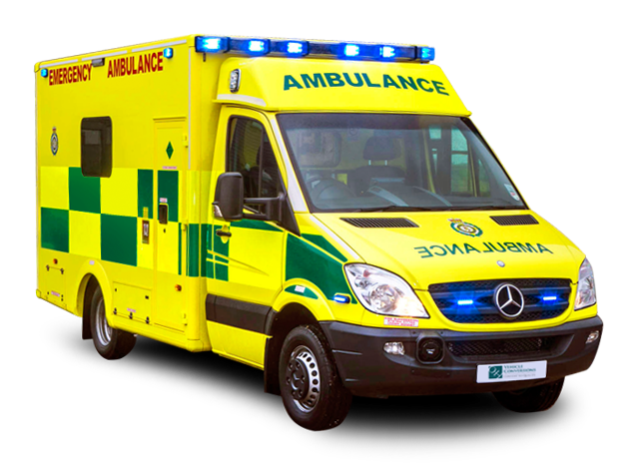
Acute Headache
Refer immediately if:
  Suspected SAH
  Suspected meningitis or
  Focal neurology or
  Papilledema
Rule out GCA

Slide 7
Suspected SAH: Ottawa rule
Investigate new headache that reached maximum within one hour if one of:
Thunderclap onset
Onset during exertion
LOC at onset
Neck pain or stiffness
Limited neck flexion on exam
Patient > 40 years
100% sensitivity, 5-10% will have SAH. Risk highest in middle-aged hypertensive smokers/drinkers that arrive in ambulance.
Perry et al: Clinical Decision Rules to Rule out Subarachnoid Headaches, JAMA 2013

Slide 8
Suspected SAH: CT +- LP
Within 6 hours: CT (A&E)
6 hours to 14 days: CT + LP (A&E or SDEC)
After that, CTA (Neurology A&G)

Slide 9
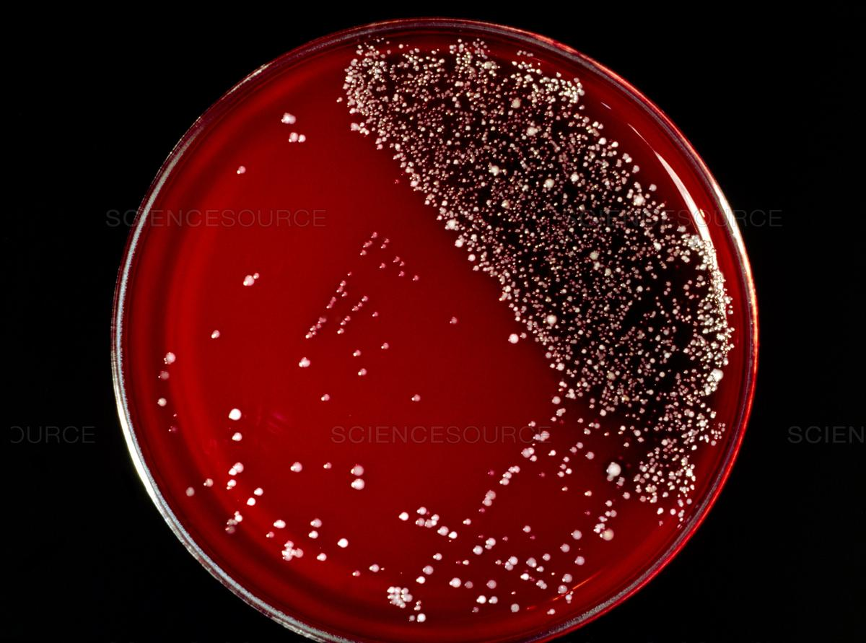
Suspected meningitis
Fever, non-blanching rash, neck stiffness, drowsiness or seizures
Send to A&E: CT, LP, cultures, treatment
Bacterial meningitis rare, but could be other serious infection

Slide 10
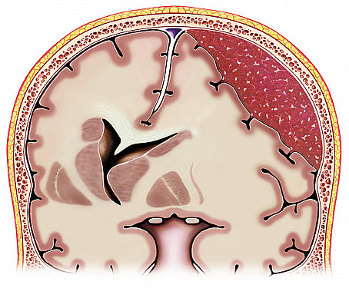
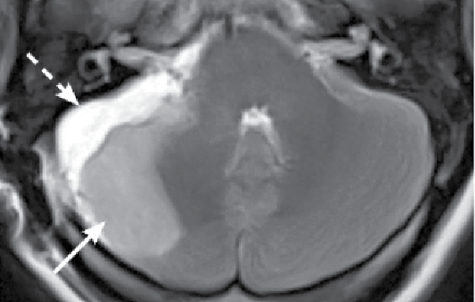
Focal neurology 1: Stroke
Dysphasia, weakness, visual field loss, ataxia
Both bleeds and infarctions can cause acute headaches, especially posterior fossa
Rarer vascular causes: venous thrombosis, RCVS, PRES, vasculitis
Send to A&E for acute stroke treatment

Slide 11

Focal neurology II: Cranial nerves
Papilledema | IIH? Venous thrombosis?
Oculomotor (nIII) | Aneurysm? Diabetes? (painless & pupil sparing)
Abducens (nVI) | Raised ICP?
Trigeminal (nV), facial (nVII), acoustic (nVIII) | CPA tumour? Meningitis? (Zoster / Lyme / TB / Sarcoidosis / carcinomatosis)
Combination 3,4,5,6 | Cavernous sinus thrombosis
Horner Syndrome | Dissection?
Send to A&E

Slide 12
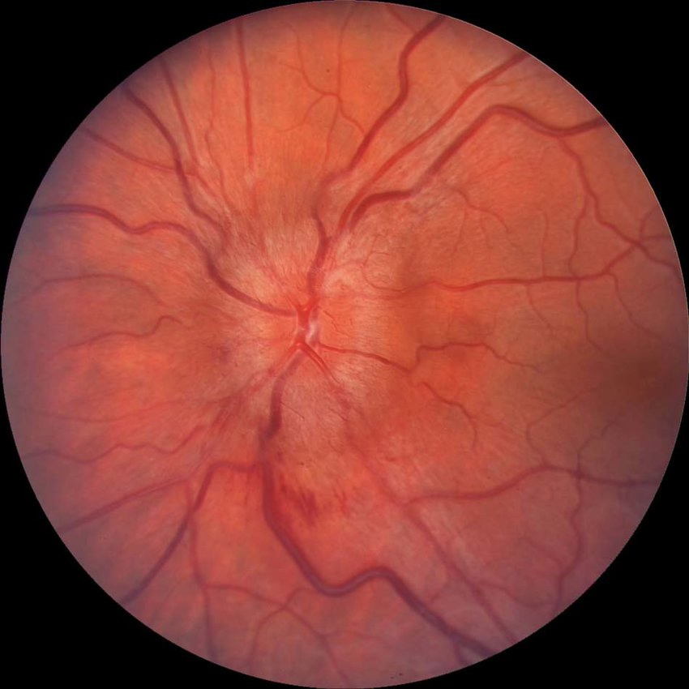
Papilledema
Refer for same day Ophthalmology review, MRV and LP. Usually IIH, but sinus thrombosis or tumour must be excluded.

Slide 13
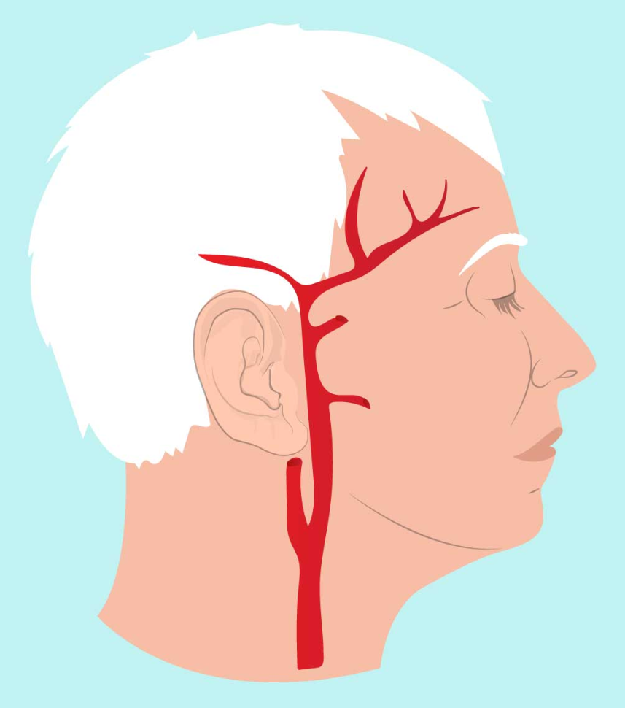
Giant Cell Arteritis
Always check ESR/CRP/FBC if patient over 50
Unilateral
Jaw claudication
Systemic symptoms
Sometimes episodic
Rapid access rheumatology

Slide 14
Acute headaches
Sudden onset
Meningism
Stroke symptoms
Cranial nerve signs
Giant Cell Arteritis

Slide 15
Plan for today
Acute headaches
When to scan
Migraine management
The new drugs

Slide 16
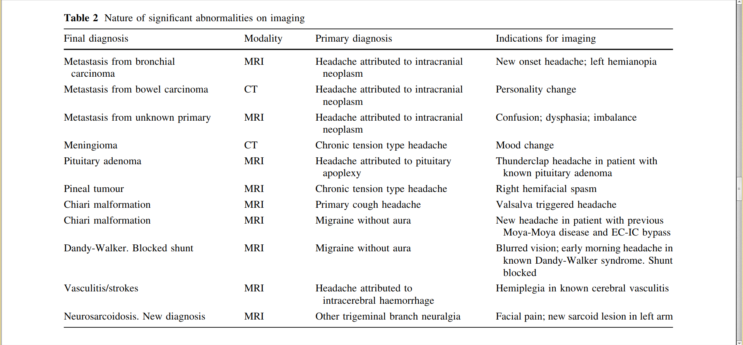
8 relevant findings, out of 3655 headache referrals
Chronic headaches only need a scan if there are clear risk factors or other neurology.
Clarke et al (Birmingham), J Neurol 2010
Notes:
These were chronic headaches that survived a neurology clinic waitlist. Urgent headaches are more likely to be secondary.

Slide 17

Red flags, and orange
Sudden onset
Systemic symptoms
Neurological deficit
Neoplasm history
Old age
Pattern change
Positional
Precipitated by coughing
Papilledema
Progressive
Pregnancy
Painful droopy eye
Post trauma
Pathology of immune system
Painkillers and other medicines
Thien Phu Do et al, Neurology 2019

Slide 18
Headaches that we usually scan
Old patient, cancer, trauma, anticoagulation, immunosuppression | tumour bleed infection | MRI
Sex/exercise: | aneurysm? | CTA/MRA if onset during activity, but not if it starts afterwards
Cough/sneeze/strain: | raised ICP? | Eye exam and MRI if brought on, and not just made worse by it. Chiari malformation?
Wake up headaches are not dangerous

Slide 19
Idiopathic Intracranial Hypertension
Typically young obese women, associated with diabetes/PCOS/OSAS. Can also be caused by medication or Addison/Cushing.
Treatment is acetazolamide, topiramate, weight loss (bariatric surgery or GLP-1 if needed).
VP-shunt or venous stenting if vision is threatened.
Mollan et al: Practical Neurology 2018

Slide 20
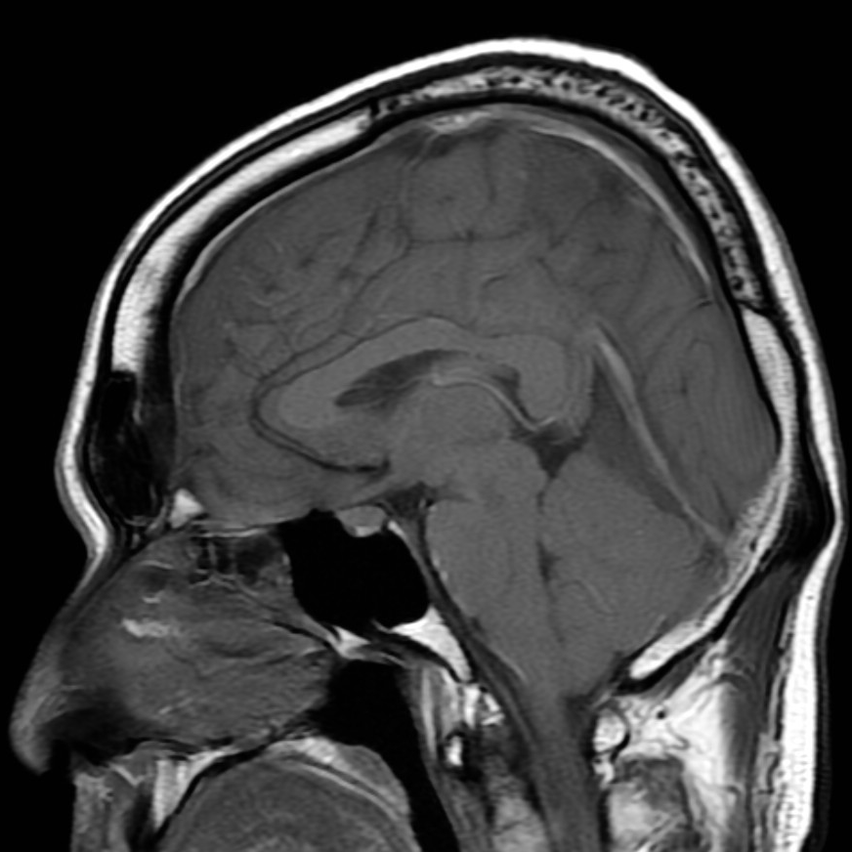
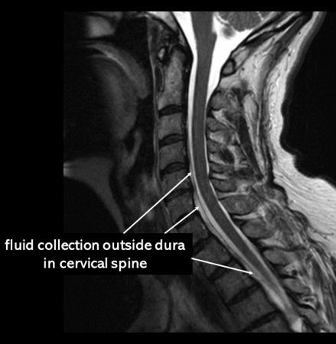
Spontaneous Intracranial Hypotension (SIH)
Headaches only on standing up. Common after LP/epidural/spinal anesthesia. Can also occur spontaneously - also then caused by CSF leak somewhere the spine.
Typical changes on MRI Brain (sagging brain + meningeal enhancement). Also do MRI Spine but this is can be normal.
Many recover within a few weeks. Otherwise treat with blood patch, and if that fails refer to tertiary centre.
Can give complications if chronic, including SDH, CSVT, superficial siderosis (balance loss and deafness)
Cheema et al: Practical Neurology 2024

Slide 21
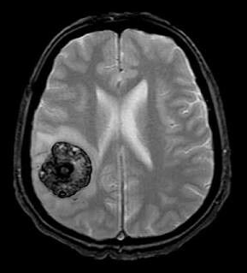
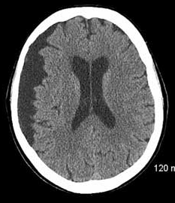
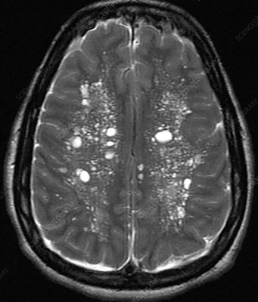
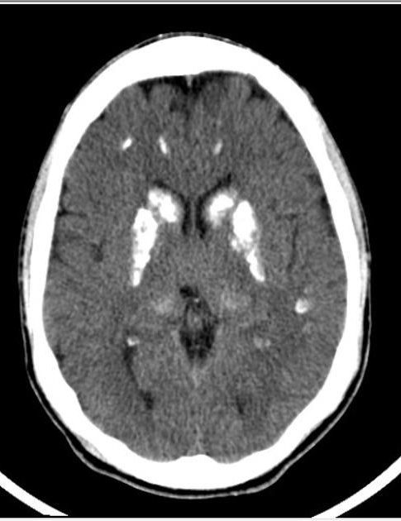
Why not scan everyone?
Not medically necessary
Also doesn’t work well for reassurance and incidental findings are common (cerebrovascular, cysts, atrophy, congenital)
Normal MRI Brain (cyst x 2, cerebrovascular disease and calcification)

Slide 22
How to get a scan?
Fast Track - only if progressive neurology - goes directly to MRI
A&G - explain why you want a scan, as per previous slide.
Email me if my colleagues aren’t convinced
Refer and wait 12 months…
Direct Access is on its way, but not all radiologists are convinced.
peter.grenholm@uhd.nhs.uk

Slide 23
Plan for today
Acute headaches
When to scan
Migraine management
The new drugs

Slide 24
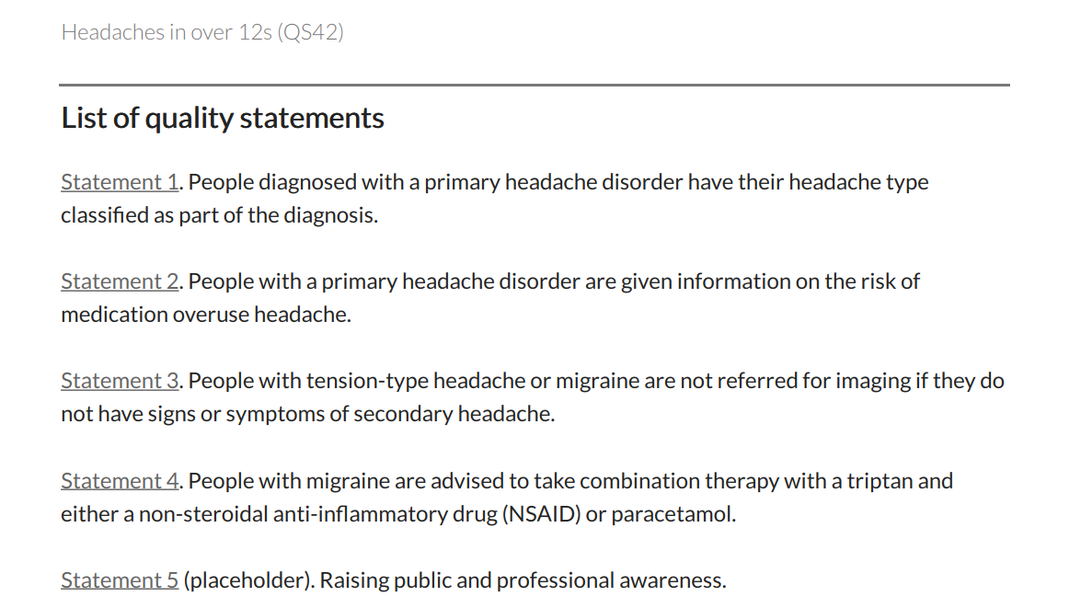
Migraine Management Basics

Slide 25
Headache in the community
Tension Type Headache | 90%
Migraine | 15%
Medication Overuse Headache | 5%
Giant Cell Arteritis | 0.5%
Cluster Headache & the hemicranias | 0.1%
Trigeminal Neuralgia | 0.1%
IIH | 0.1%
Chiari malformation | 0.1%
Lifetime prevalence

Slide 26
Headache in the community
Tension Type Headache | 90%
Migraine | 15%
Medication Overuse Headache | 5%
Giant Cell Arteritis | 0.5%
Cluster Headache & the hemicranias | 0.1%
Trigeminal Neuralgia | 0.1%
IIH | 0.1%
Chiari malformation | 0.1%
Refer or discuss with neurology

Slide 27

Episodic headaches
Migraine | Tension Type Headache
Disabling | Can continue activities
Nausea | Mild nausea
Light and sound sensitivity | Mild light sensitivity
Unilateral or bilateral | Bilateral
Throbbing | Pressure
Sometimes Aura, Prodrome and Postdrome | Waxes and Wanes

Slide 28
Episodic headaches: think migraine
Migraines are disabling headache attacks, often with dizziness, nausea, and light sensitivity, sometimes with aura or unilateral: “do the headaches ever force you to lie down in a dark room?”.
Tension type headaches are common but can often be ignored or treated with OTC medication, few see a GP for them.
Tepper et al 2004: 94% of episodic headache presenting to GP was migraine.
A self-diagnosis of migraine is usually correct
Migraine has many more treatment options

Slide 29


Headache triggers
Both migraine and TTH:
  Stress / Sleep deprivation
  Alcohol, coffee, smoking
  Dehydration / skipping meals
  Eye/Jaw/Neck tension
  Smells, light, noise
Migraine in particular:
  Wine, cheese
  Oversleeping
  Periods

Slide 30
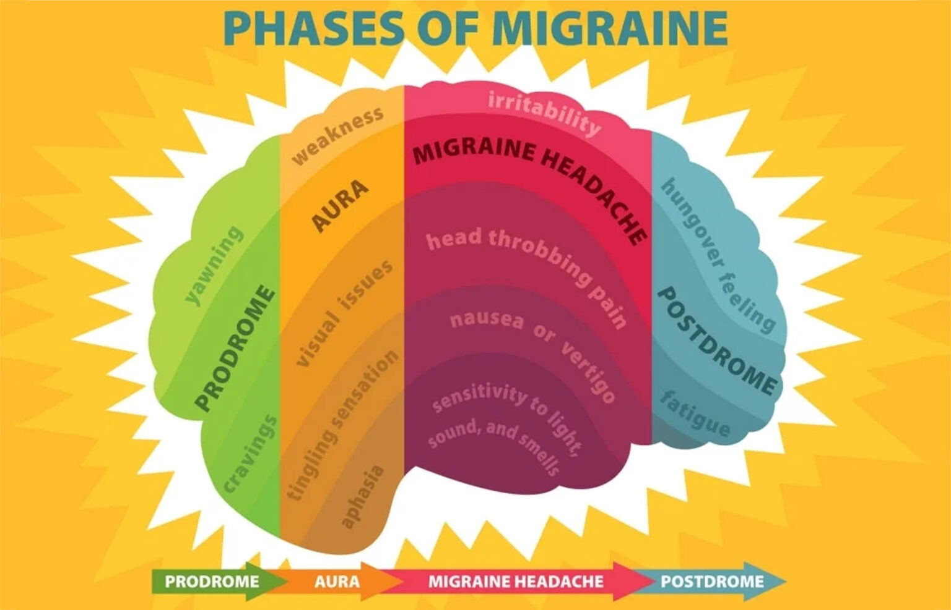

Slide 31
Chronic headache
Harder to separate - usually combination of several types
Tension type | Migraine | Medication overuse
Stress related, muscle tension | Superimposed migraines History of migraine | Painkillers > 10-15 days/month
Often poor sleep, concentration difficulties, dizziness, anxiety, low mood, fatigue.

Slide 32
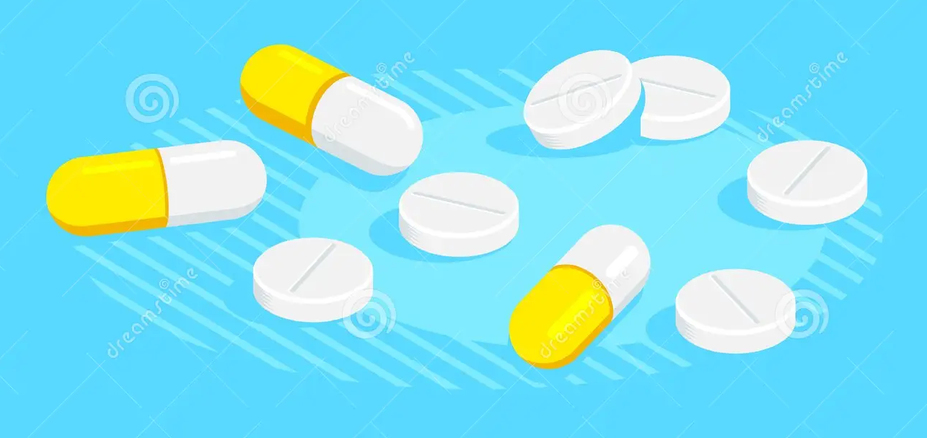
Acute TTH treatment
NSAID / Aspirin +- Paracetamol 1g
Don’t take painkillers more than 3 days in one week
Avoid opioids - high risk of side effects or medication overuse headache

Slide 33
Acute Migraine medication
Aspirin 900mg / Ibuprofen 600mg / Naproxen 500mg +- Paracetamol
Sumatriptan 50 or 100mg
Combine 1+- 2 with an antiemetic: Buccastem 3mg or Metoclopramide 10mg or Domperidone 10mg
Other triptans (rizatriptan, zolmitriptan, frovatriptan)
Sumatriptan or zolmitriptan nasal spray, or sumatriptan injection.
Rimegepant 75mg
Avoid opioids - high risk of side effects or medication overuse headache

Slide 34
Common triptan questions
Interaction with SSRI?
Pregnancy?
Hemiplegic migraine?
Vascular disease?
How many?
Age?

Slide 35
Common triptan questions
Interaction with SSRI? | not clinically relevant
Pregnancy? | sumatriptan is safe
Hemiplegic migraine? | discuss with neurologist
Vascular disease? | avoid
How many? | 10 days a month but discuss preventatives
Age? | Don’t start after 65 - but can continue

Slide 36
Rimegepant?
Use as a triptan - onset over 2 hours, effects lasts 1-2 days.
Safe in vascular disease, and doesn’t cause medication overuse headaches.
Green on the formulary for 8-10 tablets a month, if either:
  Two triptans have been tried and failed or
  Contra-indication for triptans
Few side effects (3% nausea) but a few interactions, e.g. HIV medication verapamil, carbamazepine, and antifungals.
Can also be used as preventative - more about that later.

Slide 37
Acute Migraine treatment
General approach:
If you know it’s a migraine, treat early, with high doses and combinations if needed. If it’s just a mild headache, take nothing at all.
Don’t take triptans more than 2 days a week. Take NSAID one more day if needed.
Use your headache diary to become better at this
Avoid opioids - high risk of side effects or medication overuse headache

Slide 38
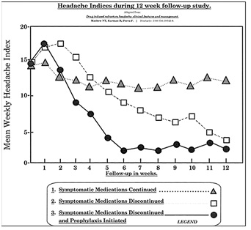
Medication overuse headache
Try withdrawal if chronic headaches and
  Opioids >1 d/week
  Triptans or combination pills >2 days/week
  NSAID/Paracetamol >3 days / week
Helps around 50% within weeks
Might need bridging with Naproxen / Buccastem and support from family/physio/nurse
Discuss preventatives
The cause is unclear, but likely a combination of central sensitization, psychological factors, and migraine predisposition
Kristofferson, JNNP 2015

Slide 39
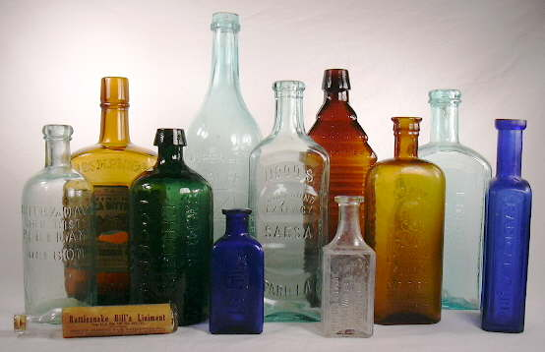

Supplements
Riboflavin 400 mg
Magnesium 400 mg
Coenzyme Q10 150 mg
Lifestyle Advice
Avoid caffeine, alcohol
Exercise
Regular sleep routines
migrainetrust.org

Slide 40

Complementary
Acupuncture (has evidence but I can’t easily refer)
Cefaly (not funded, probably little effect)
GammaCore (only funded for cluster headache)

Slide 41
Preventative migraine medication
Migraine patients are often sensitive to side effects - start at low dose.
Manage expectations - explain that migraine is a chronic condition and that good effect means 30-50% headache reduction after two months.
Evaluate with a headache diary. If no effect increase dose.
Until now all oral preventatives were developed for something different, so most have poor evidence and are off license.

Slide 42
Preventative migraine medication
Medication | Dose | Side effects | Suitable when
Candesartan | 8mg daily | Hypotension | Stroke risk/high BP
Propranolol | 40mg tds | Hypotension, cold hands, fatigue, asthma | Anxiety/palpitations/tremor/high BP
Atenolol | 50 mg daily
Amitriptyline | 30mg at night | Sleepiness, memory, dry eyes | Insomnia, pain
Duloxetine | 60mg daily | Weight gain, brain fog | Pain, anxiety
Venlafaxine | 75 mg daily
Topiramate | 50mg bd | Brain fog, anxiety, | Tremor, chronic migraine
Start lower, and go to double dose if needed.
bash.org.uk/for-clinicians
dorsethead.uk

Slide 43
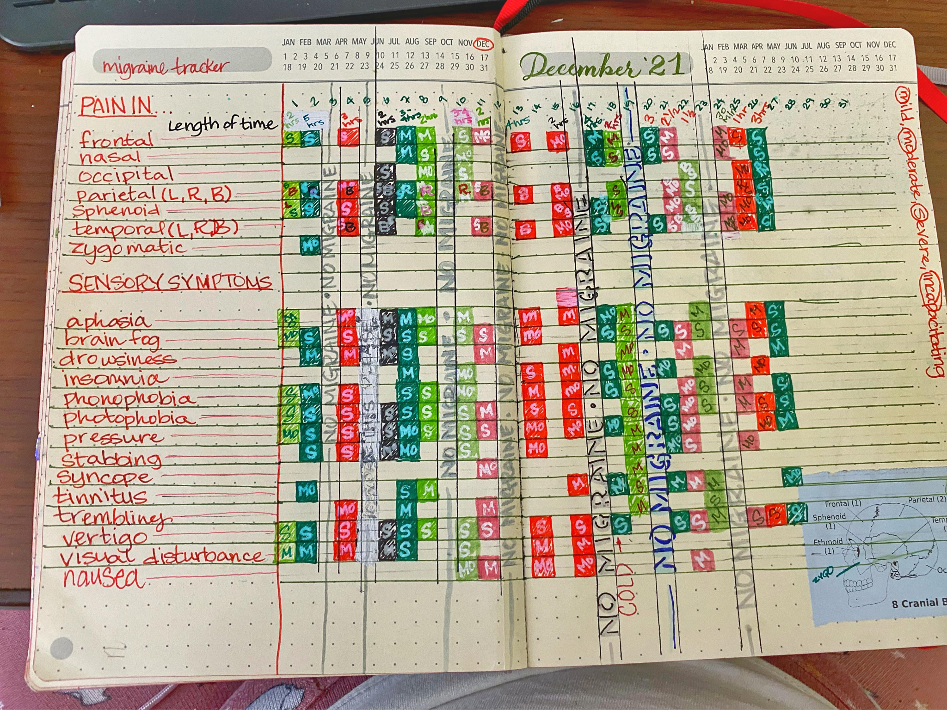
Or, use an app

Slide 44
Plan for today
Acute headaches
When to scan
Migraine management
The new drugs

Slide 45

Dorset Headache Service
Advanced treatment for refractory migraine (botox, anti-CGRP, nerve blocks)
Clinics in Poole and Bournemouth
ACP, headache nurse Becki Tyler, dorsetheadacheservice@uhd.nhs.uk
Peter Grenholm, peter.grenholm@uhd.nhs.uk
Website dorsethead.uk

Slide 46
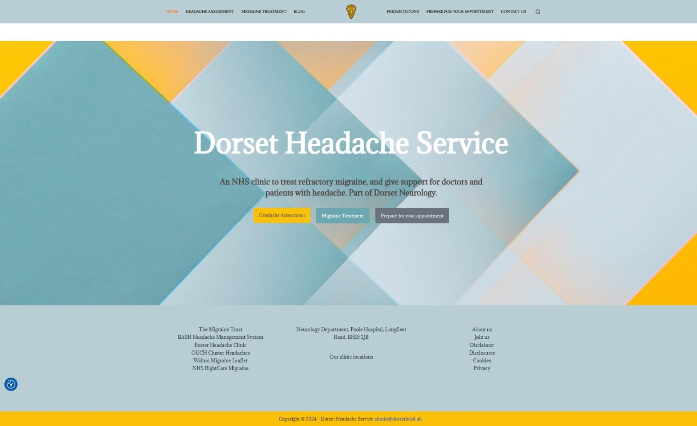

Slide 47
Advanced migraine treatment
 |  | X | X | X | X | X
X | X | XX | XX | X | X | X
X | X | X | XX | XX | XX | X
XX | X | X | XX | XX | X | X
X | X | O | X
Tried 3 oral preventatives
Medication overuse has been addressed
For botox: >15 headache days / month
Refer to neurology, will be seen by me, and treated by Becki

Slide 48

Emgality/Ajovy/Aimovig
CGRP antibody
Once monthly self injection
Not tried in cardiovascular disease, or in pregnant patients, but otherwise minimal side effects (constipation)
Often quick effect

Slide 49
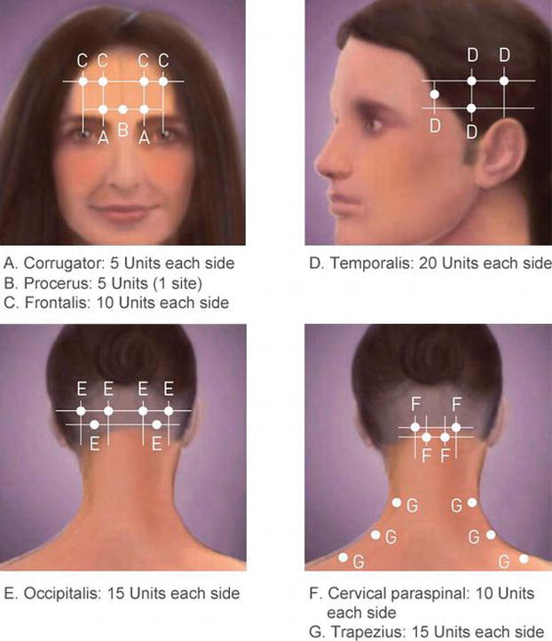
Botox
31 injections every three months. Slow effect, we always give two sets at least
Side effects are transient:
  pain,
  slanted eyebrows or a
  wobbly head

Slide 50
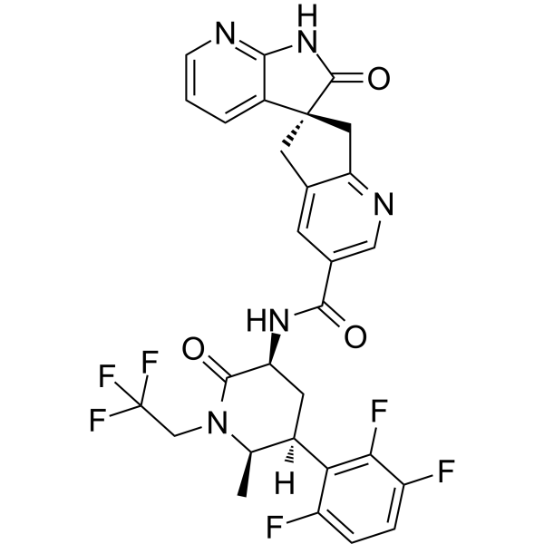
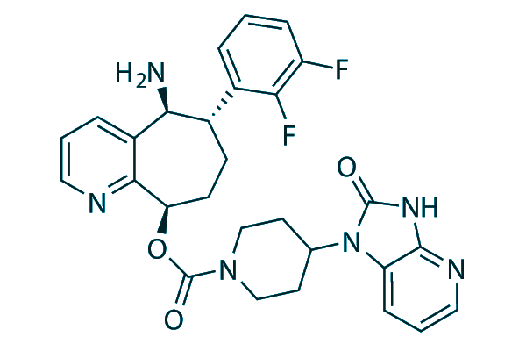
Gepants for prevention
Rimegepant (Vydura) 75mg
One tablet alternate days
Episodic migraine with 4-15 headache days/month.
Atogepant (Aquipta) 60mg
One tablet every day
Chronic or episodic migraine with 4-31 headache days/month
Three standard preventatives have been tried and failed.
Red on formulary, will soon change to amber/advice

Slide 51
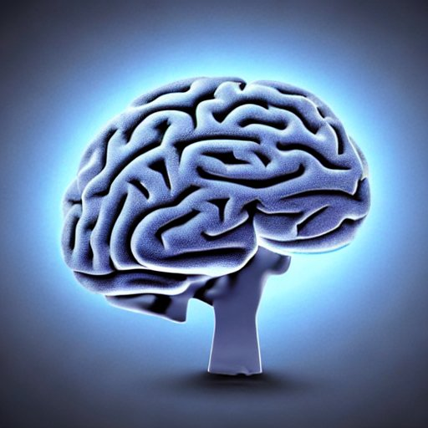
Take home message
A&E review if sudden onset, stroke/meningitis, papilledema or cranial neuropathy. Check ESR.
Eye check & scan if cough, sex, cancer, trauma, anticoagulants, or immunosuppressants
Otherwise, it's usually migraine: discuss lifestyle, prescribe triptans and warn about medication overuse. Try three preventatives before referring.
More info: migrainetrust.org, dorsethead.uk

Slide 52
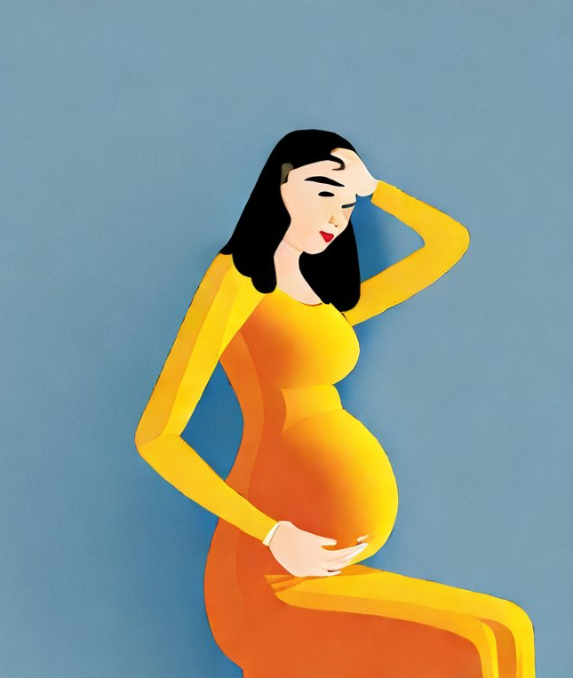
Migraine and pregnancy
Headache often better in 2nd and 3rd trimester, nausea a problem before that.
Paracetamol safe, as is occasional sumatriptan. NSAID until week 34.
Beta blockers and amitriptyline safe until week 34, with caution after that. The other preventatives are unsafe.
Acupuncture, riboflavin, CEFALY and other devices…

Slide 53
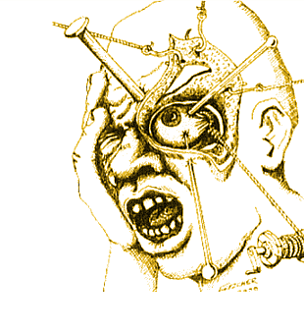
Cluster headache
2-8 attacks every 24 hours, more at night.
Centered around one eye, often tearing, swelling or Horner syndrome.
Usually clusters lasting weeks, with free intervals
Prescribe sumatriptan nasal spray or injection up to 4 times daily.
Refer to neurology: oxygen, verapamil …
Migraine can have similar eye symptoms, but time pattern differs.
Website ouchuk.org

Slide 54
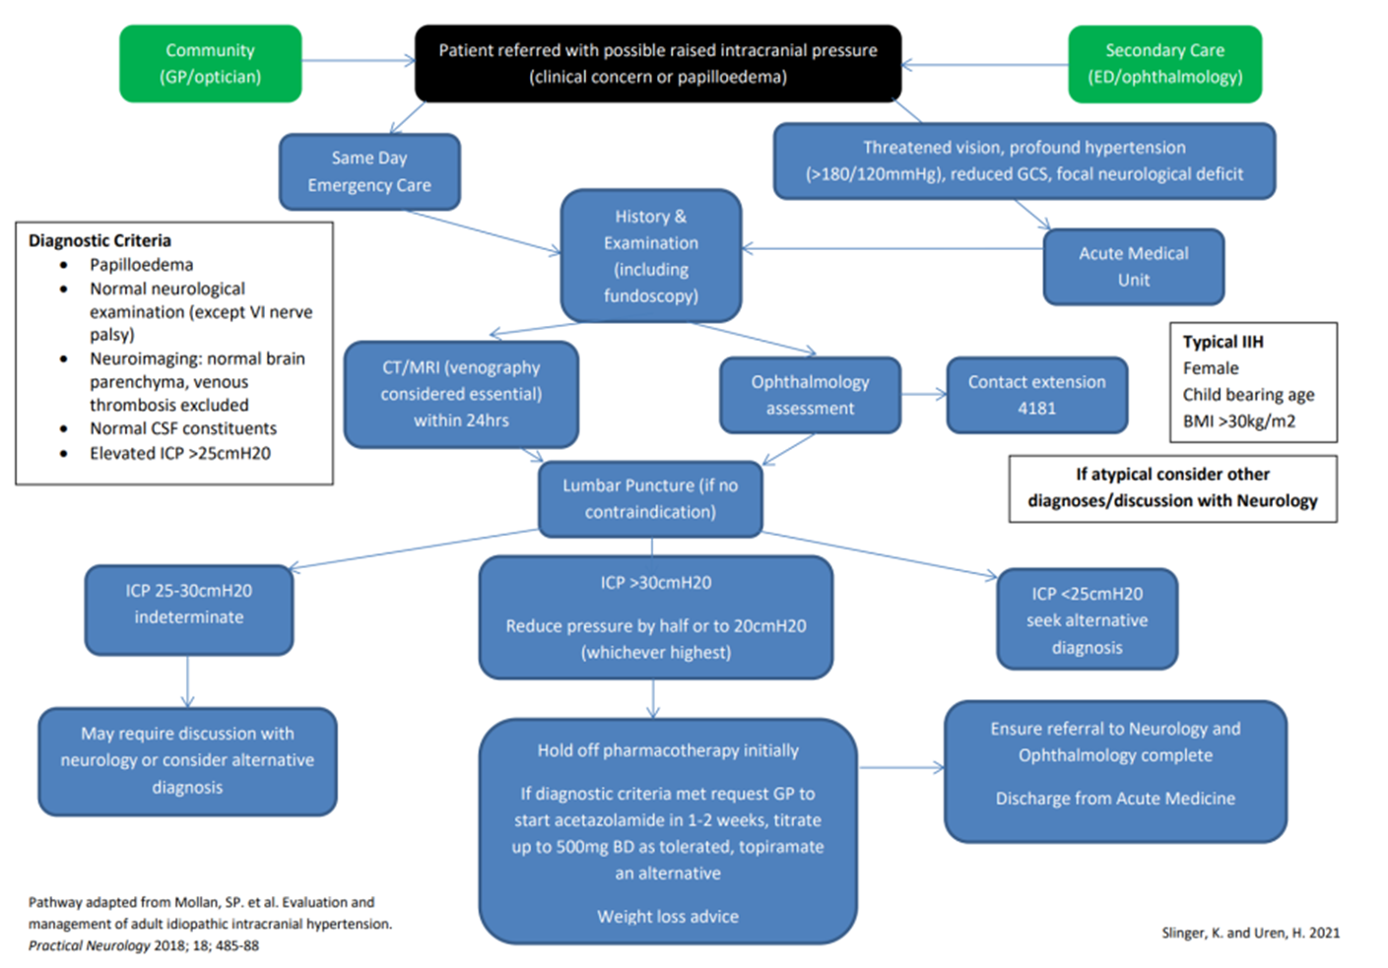

Slide 55
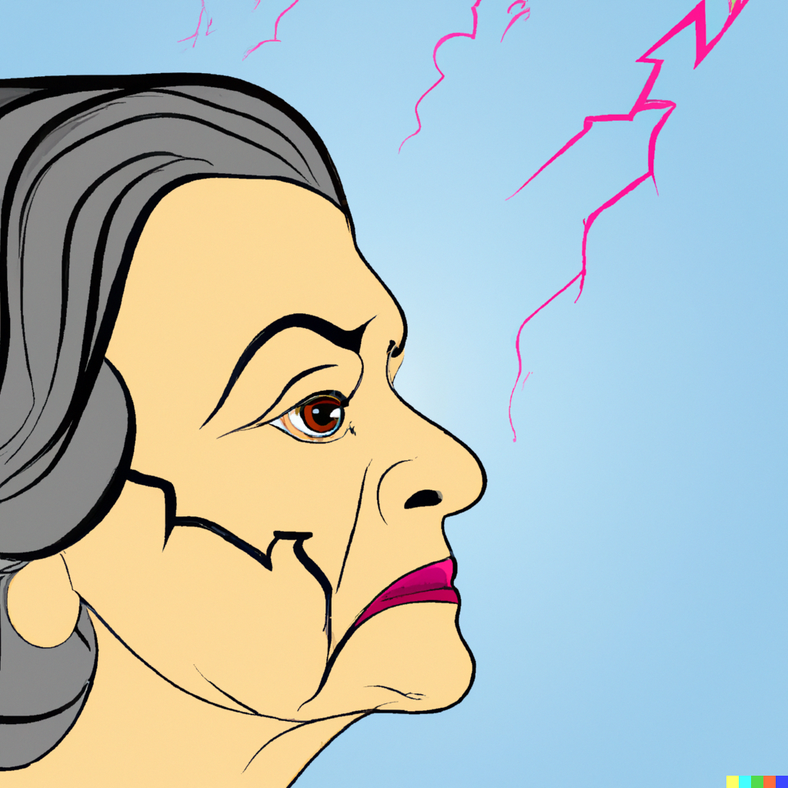
Trigeminal Neuralgia
Brief attacks, triggered by cold, touch, eating
Usually lower jaw, always one-sided, neuralgic.
Overdiagnosed - look for dental/TMJ cause
Need imaging if age < 40, or if sensory loss
Treated with high doses carbamazepine or gabapentin
Refer to neurology or maxillofacial if refractory

Slide 56


